Slide 1
Inventory & Supply Chain Management Analysis

Slide 2
Project Overview :
This project provides a comprehensive analysis of inventory and supply chain efficiency. By integrating data from procurement and sales, the project identifies bottlenecks, optimizes stock levels, and provides actionable insights through data visualization. The workflow covers the full data cycle: Excel, Transformation (PQE), and Visualization (Power BI).

Slide 3
Problem Statement :
Inconsistent inventory tracking often leads to:
Capital Loss: Money tied up in overstocked, slow-moving items.
Lost Revenue: Frequent stockouts of high-demand products.
Operational Delays: Unmonitored supplier lead times causing production halts.
This project solves these issues by automating the calculation of safety stocks, reorder points, and identifying product categories that require the most attention.

Slide 4
Dataset Information :
Domain: Supply Chain & Warehouse Management
Data Points: ~[Insert Number, e.g., 2,000+] Rows
Key Columns:
Product_ID, Category, Warehouse_Location
Unit_Cost, Selling_Price, Quantity_on_Hand
Lead_Time, Reorder_Point, Supplier_Performance_Rating

Slide 5
Tools & Technologies Used
Microsoft Power BI: Developed an interactive dashboard to monitor KPIs.
DAX: Created custom measures for Inventory Turnover Ratio and Stock-to-Sales Ratio.

Slide 6
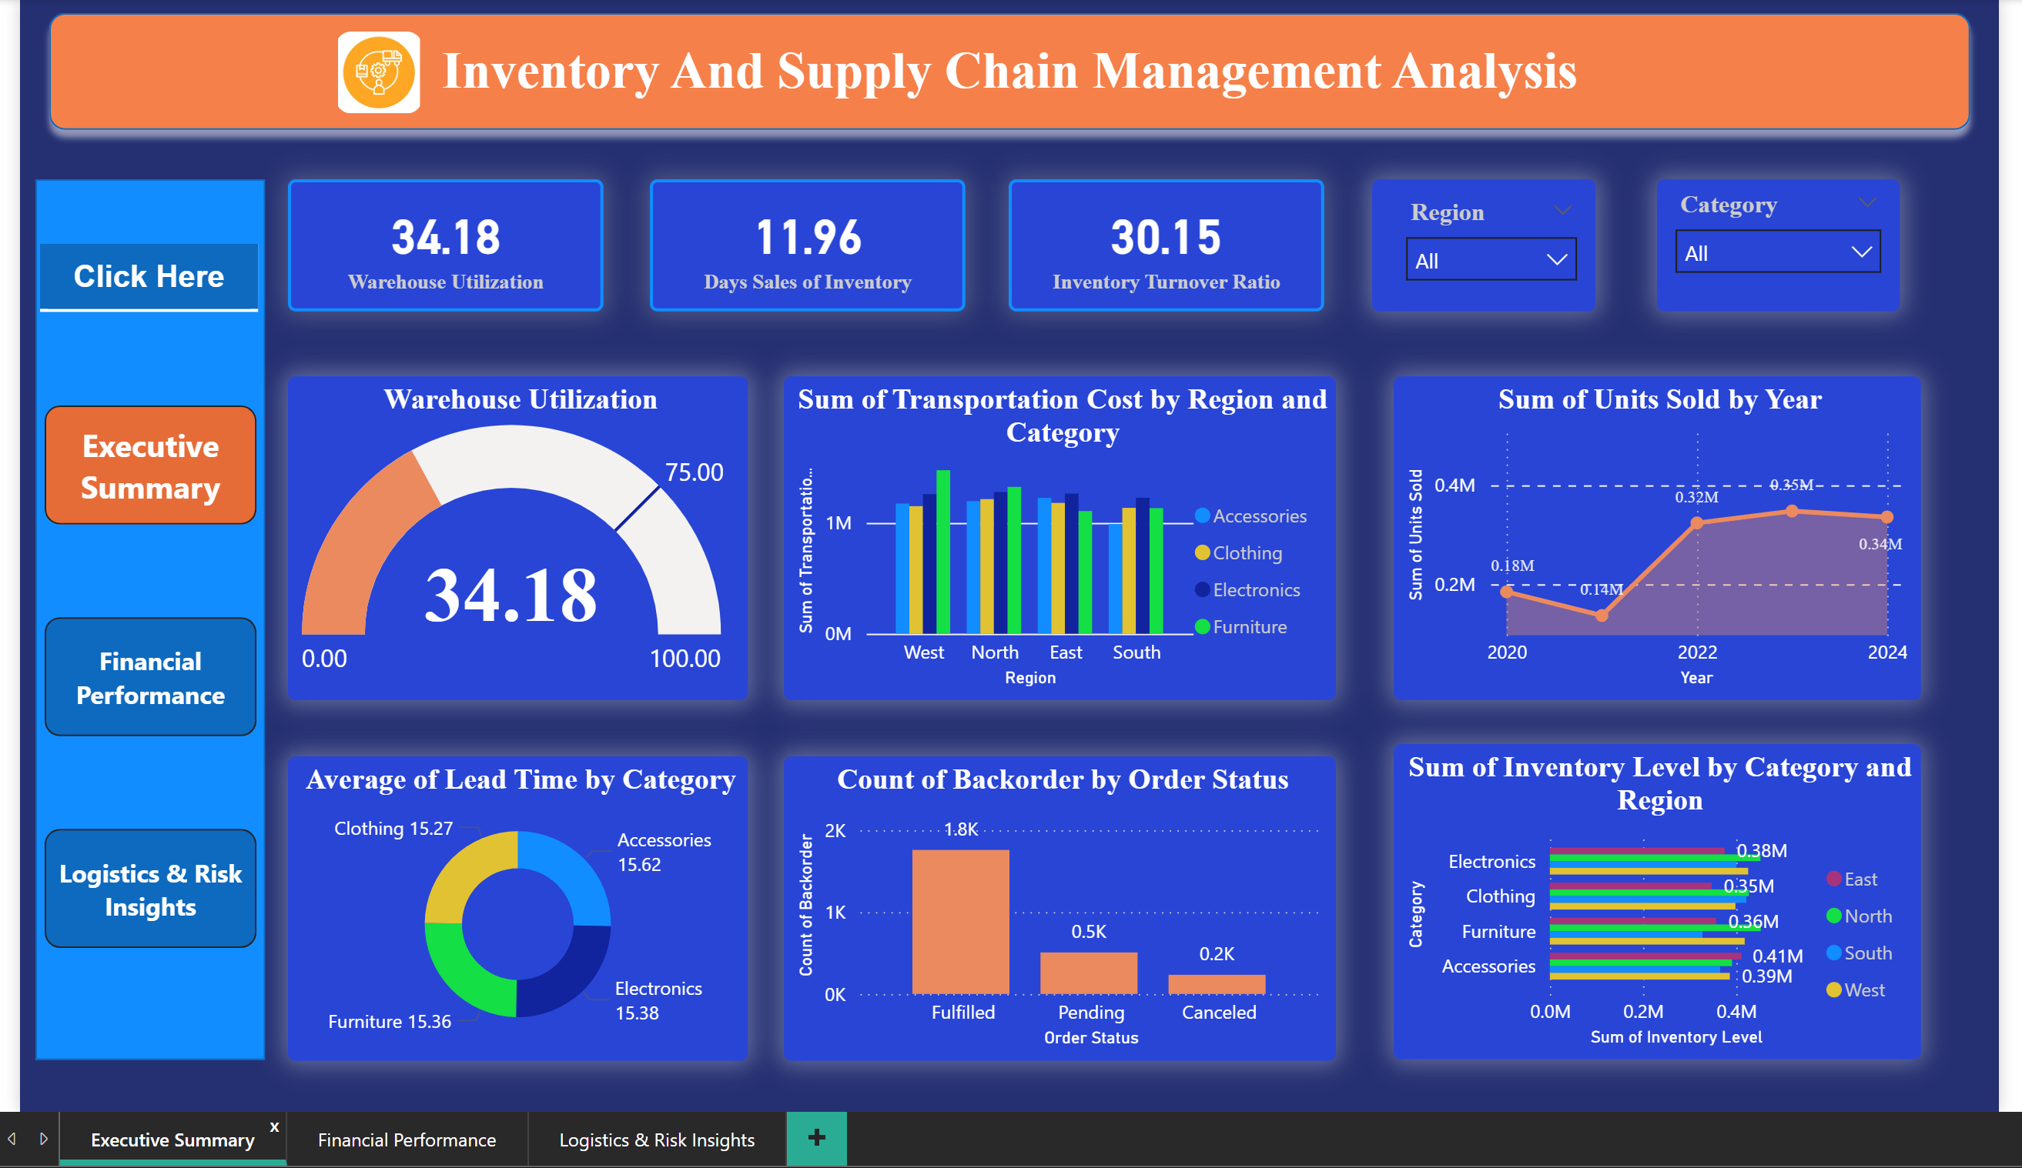
Dashboard Preview :

Slide 7
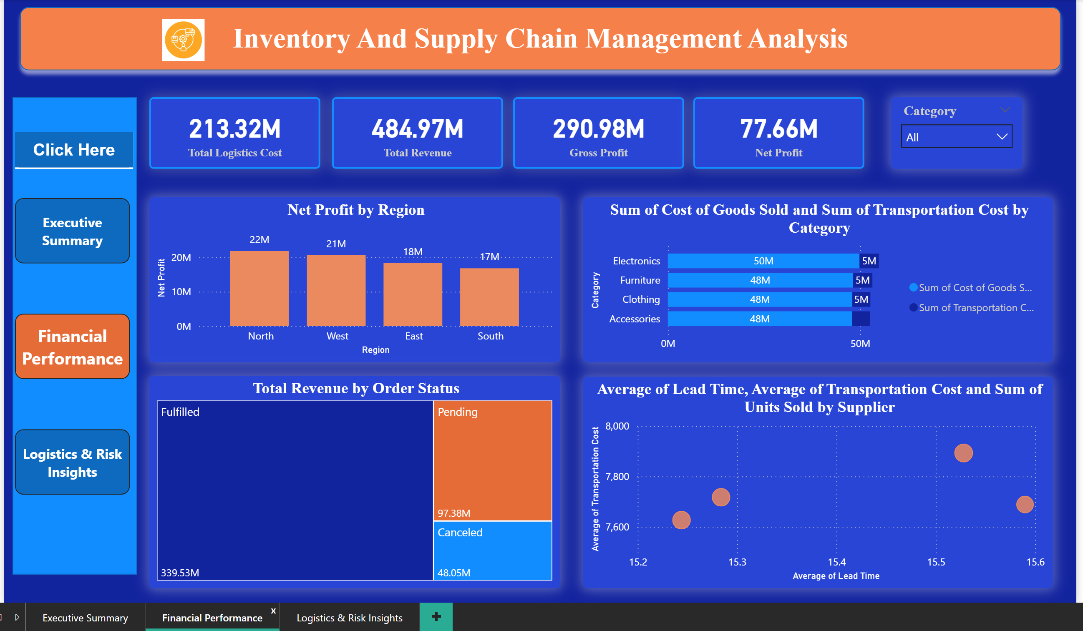

Slide 8
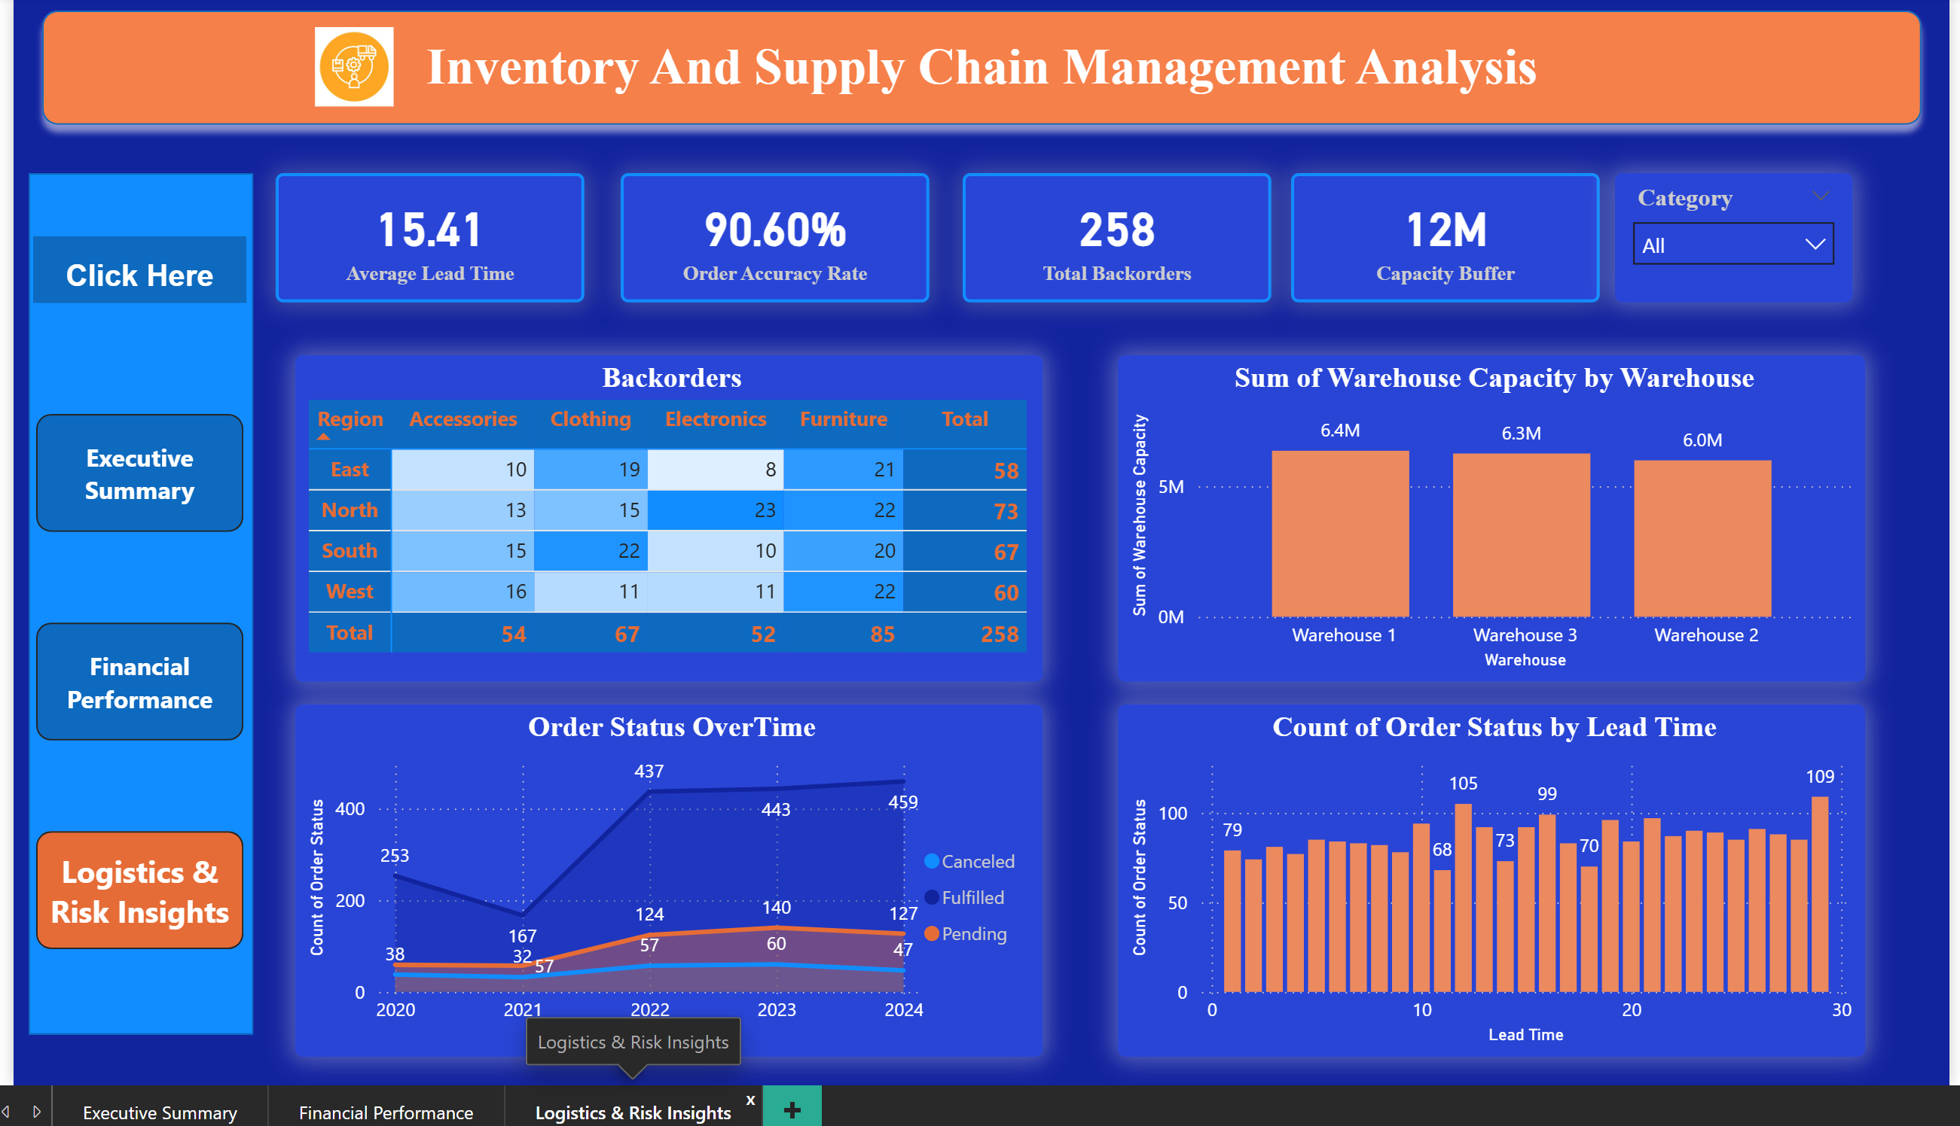

Slide 9
Future Enhancements
Demand Forecasting: Implementing a Time-Series model in Python (ARIMA/Prophet) to predict future stock needs.
Live API Integration: Connecting the dashboard to a real-time warehouse management system.
Cost Optimization: Adding a module to calculate the Economic Order Quantity (EOQ) for all Category A items.

Slide 10
Conclusion :
This project successfully bridges the gap between raw logistics data and strategic business decisions. By implementing these data-driven insights, a business can expect reduced holding costs and a more resilient supply chain.

Slide 11
Thank You!

